Slide 1
Unit III : Parallel Port Interfacing-II
Interfacing of: DAC, Temperature sensors, Stepper motor, Motion detectors, Relay, Buzzer, Optoisolaters, Design of DAS and Frequency counter:All programs in assembly

Slide 2
Digital to Analog Converter (DAC)
Methods of creating DAC:
Binary weighted
R2R ladder
DAC 0808 is considered in our example
Criterion for DAC:
Resolution: No. of binary inputs
In DAC 0808 the digital inputs is converted to current (Iout)
A I-V convertor may be used to convert the result into voltage.

Slide 3
Wave form generation using DAC 0808
Write an ALP to generate following waveforms using DAC 0808: (Show the waveform on DSO)
Square wave/ Rectangular
Triangular/ ramp
Sine
Interfacing diagram
Algorithm
Calculation according to frequency of waveform and its duty cycle.

Slide 4
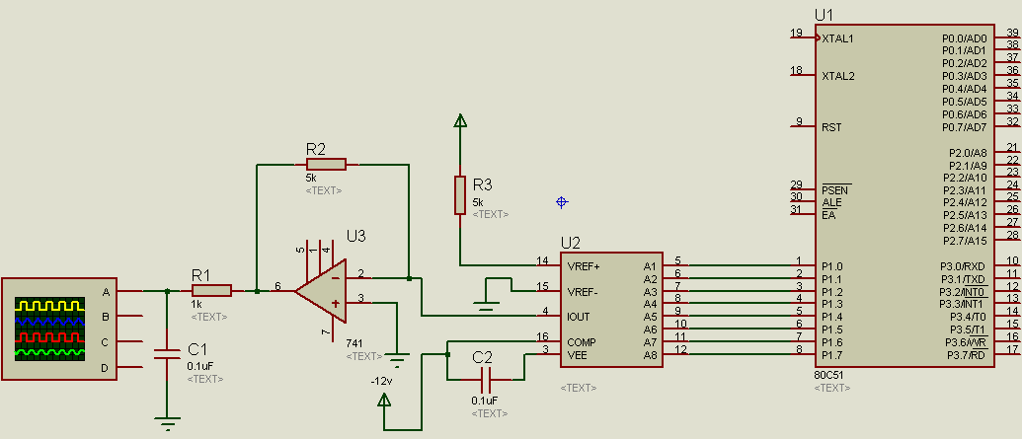
Interfacing diagram

Slide 5
Interfacing of Relay
What is a Relay?
Working principle and construction of a Relay
Need of interfacing a Relay to microcontroller
Interfacing diagram
Program

Slide 6
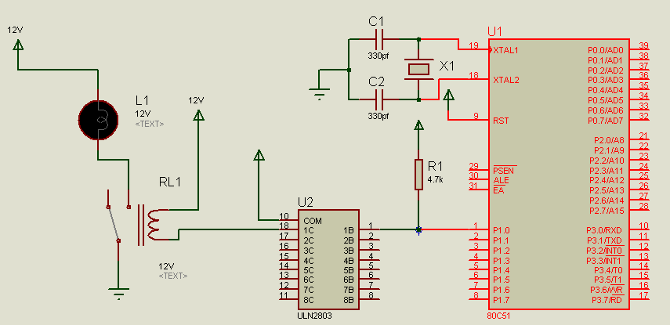
Interfacing diagram
Explanation: The Relay has 6 terminals for connections.One of terminals of the coil is energized or denergized by connecting it to port pin. The current provided by port pin is only 1 – 2 mA. Relay coil requires current of at least 10mA. Hence a driver, such as ULN2803 is used between 80c51 and Relay. There are two contacts, NC and NO where device to be controlled can be attached.

Slide 7
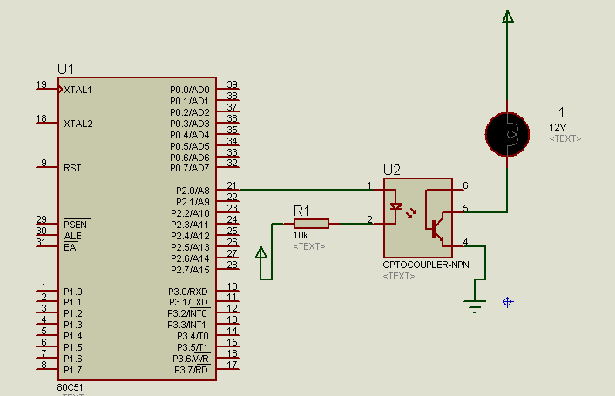
Optoisolator/optocoupler
What is a Optoisolator?
Working principle and construction of a Optoisolator
Need of interfacing a Optoisolator to microcontroller
Interfacing diagram
Program

Slide 8
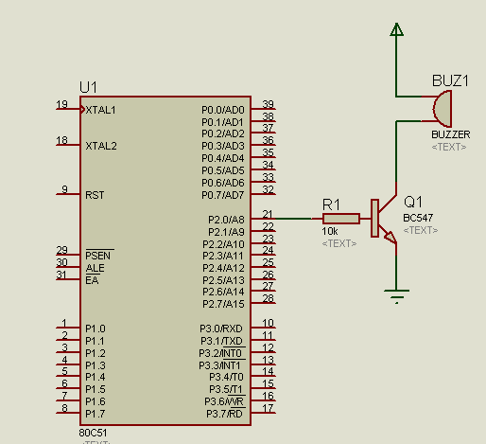
Buzzer Interfacing
Connect Buzzer to P2.0 pin of microcontroller through a npn transistor BC 547.
Make the pin high to turn on the buzzer.
Make the pin low to turn off the buzzer.

Slide 9
Motion Sensor : PIR working principle
PIR sensor is the abbreviation of Passive Infrared Sensor. It measures the amount of infrared energy radiated by objects in front of it. They does not emit any kind of radiation but senses the infrared waves emitted or reflected by objects. Suitable lenses are mounted at the front of the sensor to focus the incoming radiation to the sensor face. When ever an object or a human passes across the sensor the intensity of the of the incoming radiation with respect to the background changes. As a result the energy generated by the sensor also changes. Suitable signal conditioning circuits convert the energy change to a suitable voltage output. In simple words the output of a PIR sensor module will be HIGH when there is motion in its field of view and the output will be LOW when there is no motion.

Slide 10
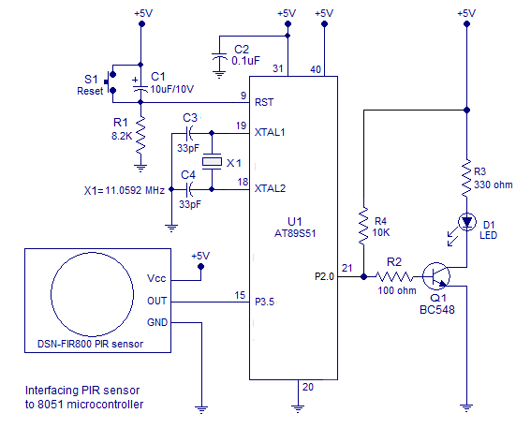
Interfacing Diagram
The circuit shown above will read the status of the output of the PIR sensor and switch ON the LED when there is a motion detected and switch OFF the LED when there is no motion detected. Output pin of the PIR sensor is connected to Port 3.5 pin of the 8051.

Slide 11
Temperature Sensor
Block diagram
Explanation:
LM 35 series sensors are precision integrated circuit temperature sensors whose output voltage is linearly proportional to the Celsius.
It outputs 10mV for each degree change in temperature
Signal condition for I-V conversion ,amplification
Set Vref to 2.56 V to get full scale Vout.
Analog signal (Temperature)
Transducer (LM 35)
Signal conditioning
ADC (ADC 0808)
Microcontroller (8051)

